Slide 1



Design of efficient 4x4 Enhanced Pipeline multiplier Based with Various Optimization Techniques
Yazeed Hamdan, osaid hamza, Mahmoud hamdan 1201133, 1200875, 1201134

Slide 2
Contents
Abstract Our project about creation of a 4x4 Enhanced Pipeline Multiplier optimized through various straightforward techniques to improve its efficiency and speed. Our design built using electric tool, and it focuses on refining the standard multiplication process.
Abstract
Design and Implementation
Results and simulations
POWER AND DELAY OPTIMIZATION
Conclusion

Slide 3
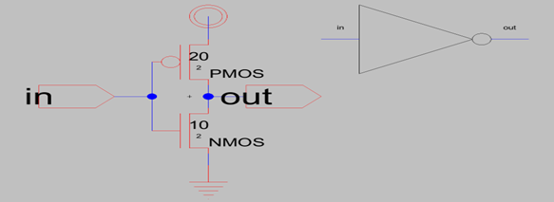
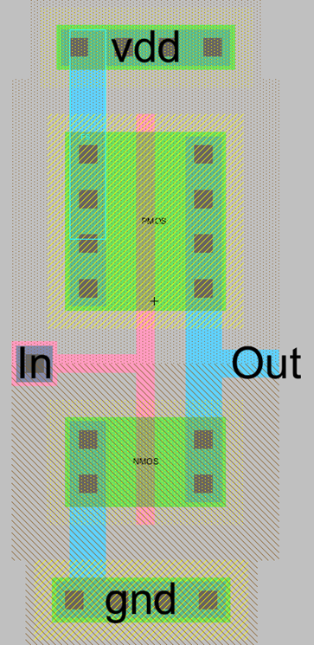
Design and Implementation Invertor → Schematics and Layout design

Slide 4
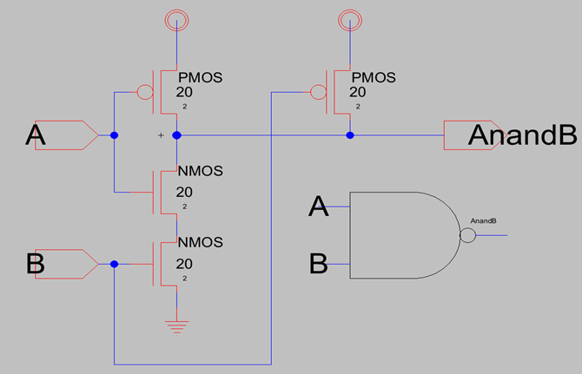
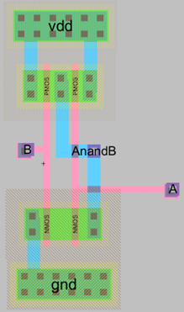
NAND → Schematics and Layout design

Slide 5
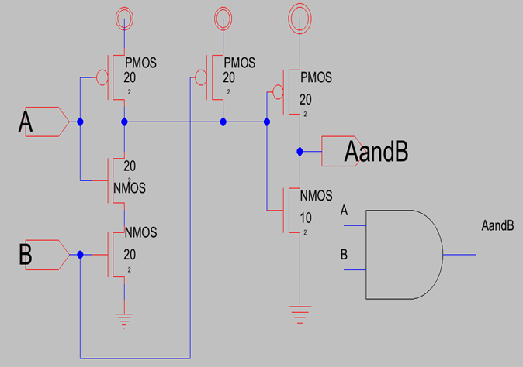
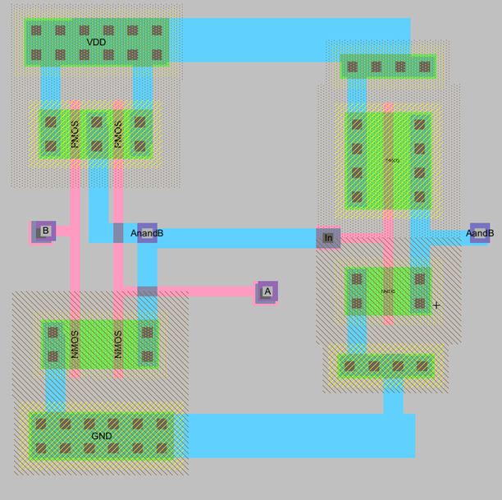
AND → Schematics and Layout design, Truth table

Slide 6
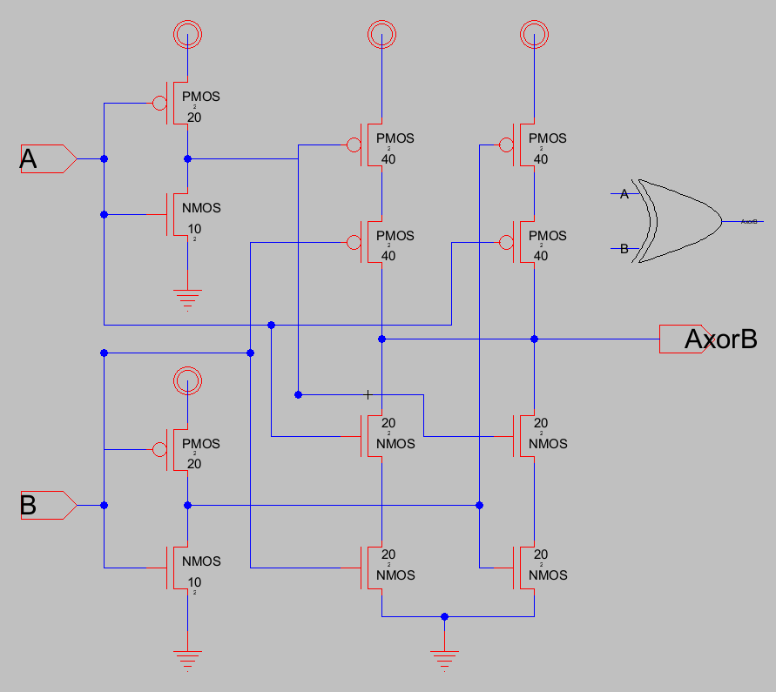
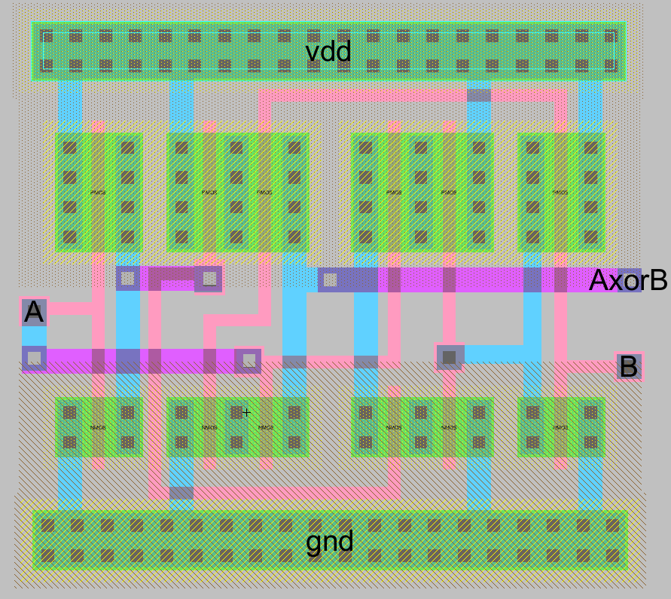
XOR → Schematics and Layout design

Slide 7
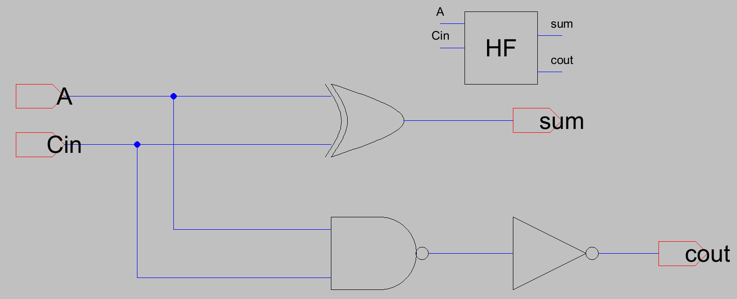
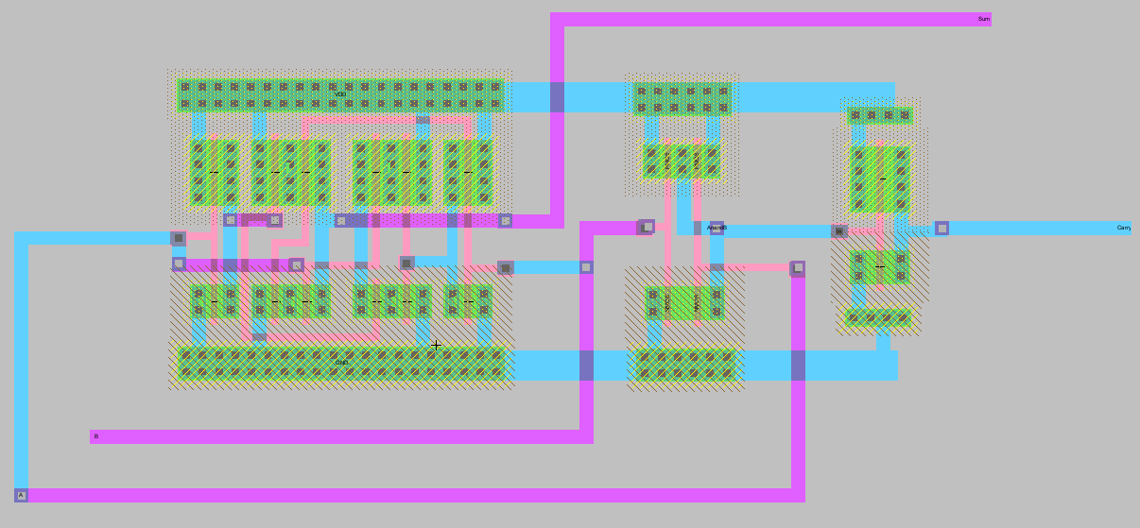
Half adder → Schematics and Layout design

Slide 8
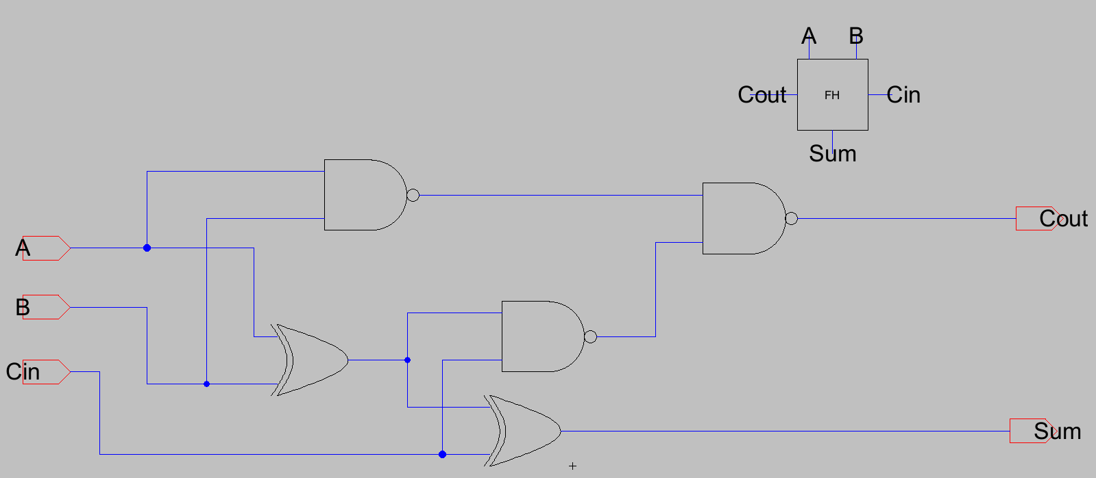
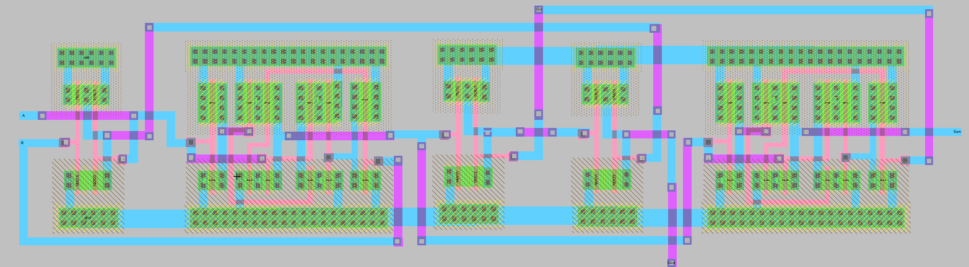
Full adder → Schematics and Layout design

Slide 9
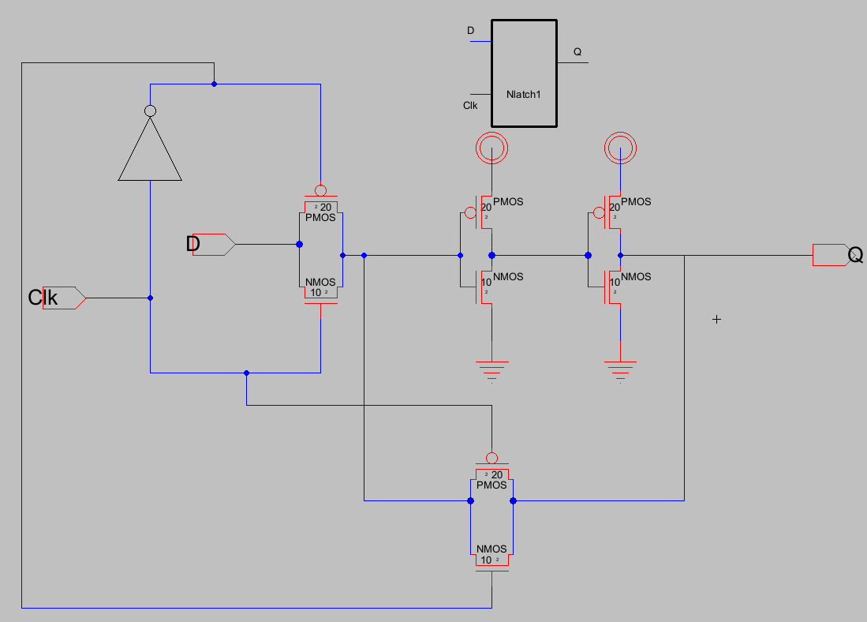
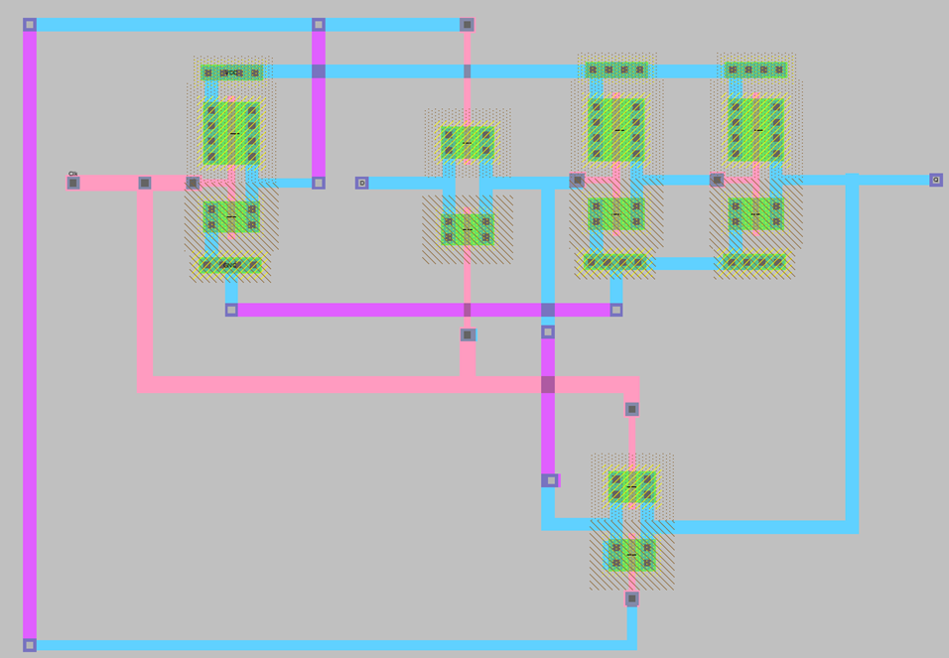
N-Latch → Schematics and Layout design

Slide 10
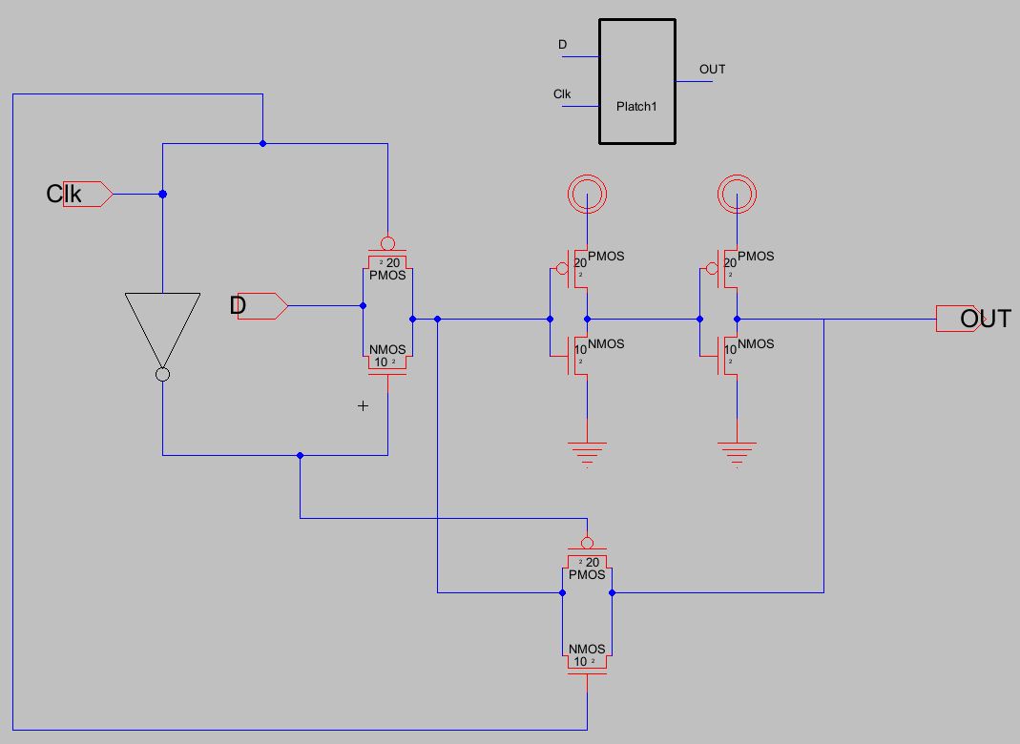
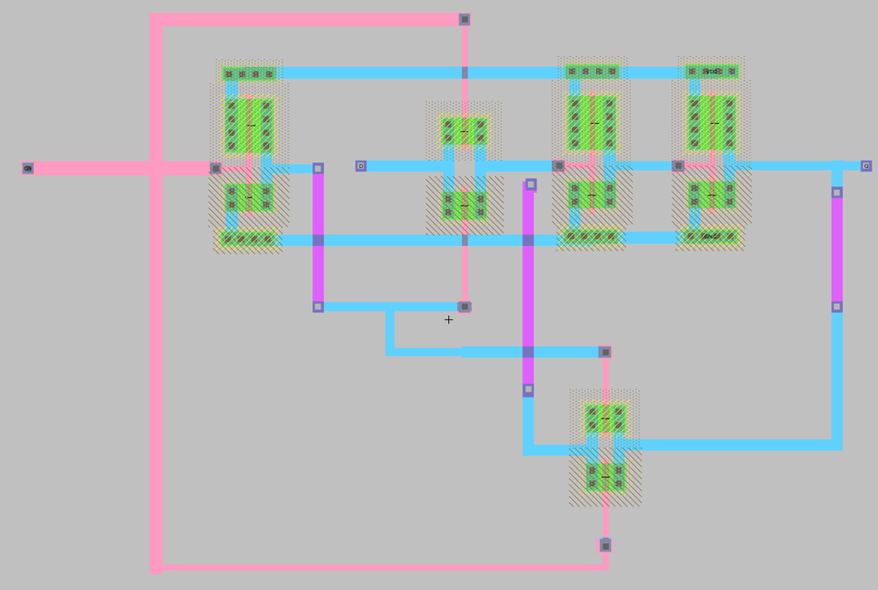
p-Latch → Schematics and Layout design

Slide 11
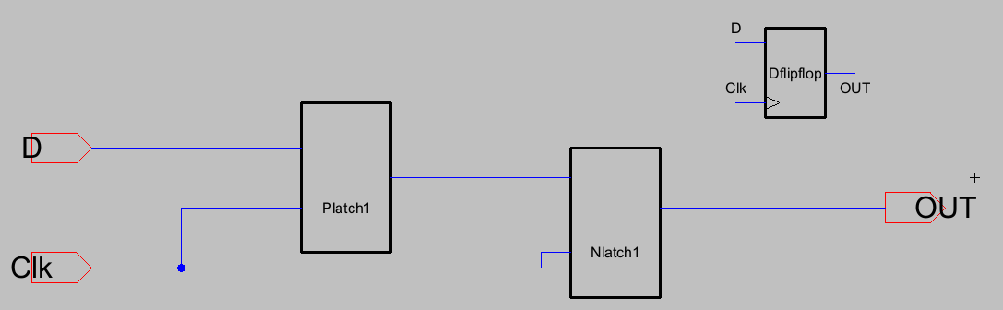
D-Flip flop → Schematics design

Slide 12
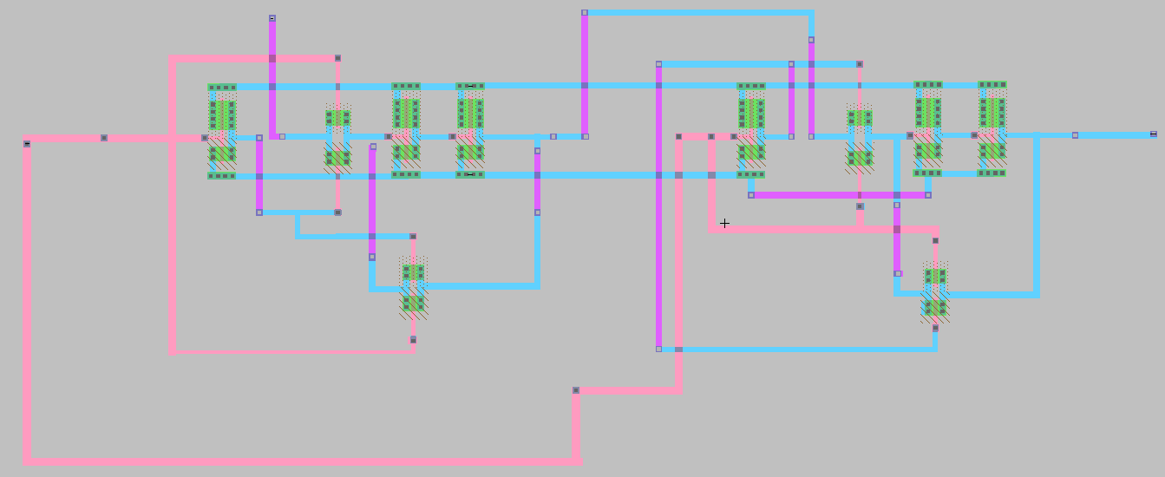
D-Flip flop → layout design

Slide 13
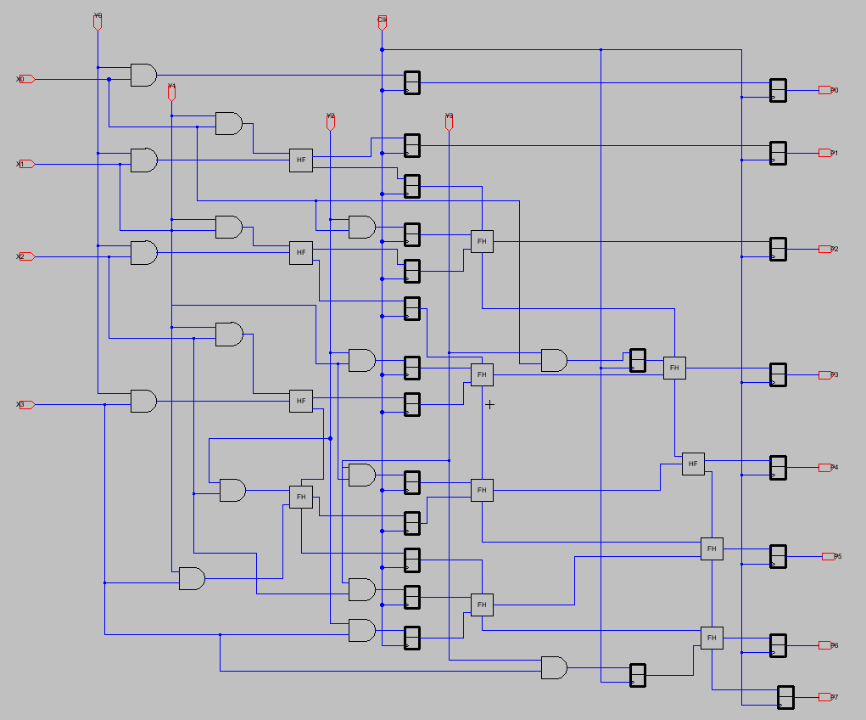
4x4 Enhanced Pipeline multiplier → Schematics design

Slide 14
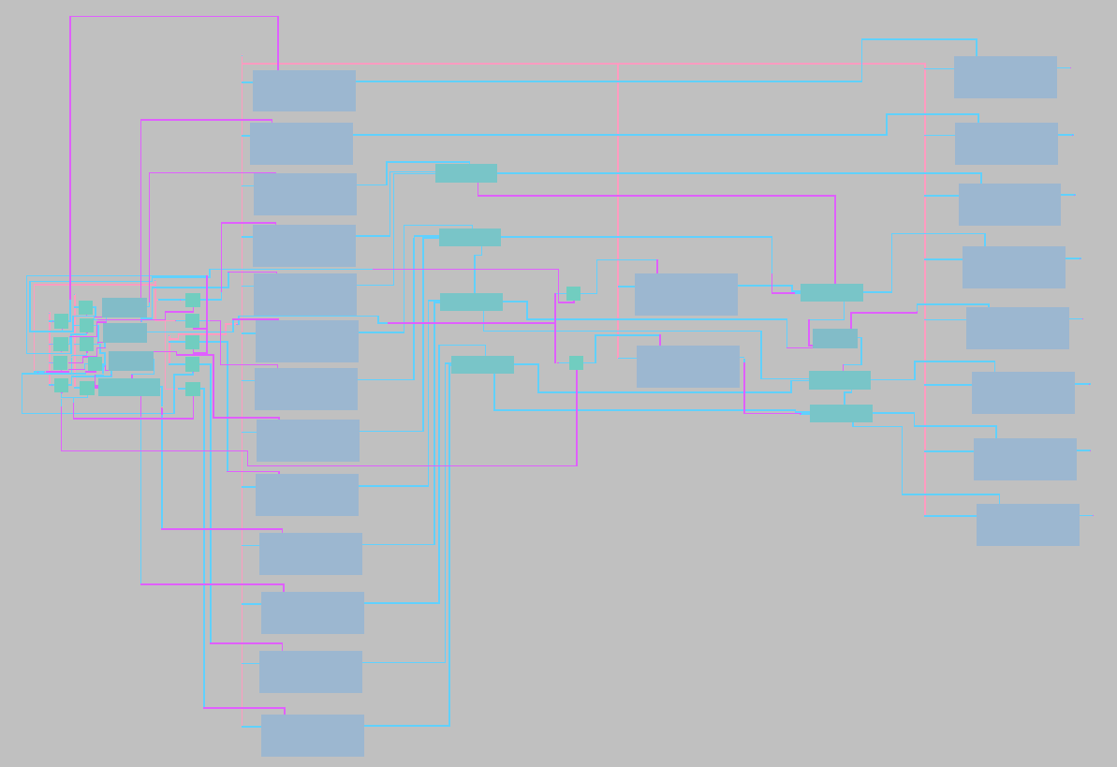
4x4 Enhanced Pipeline multiplier → Schematics design

Slide 15
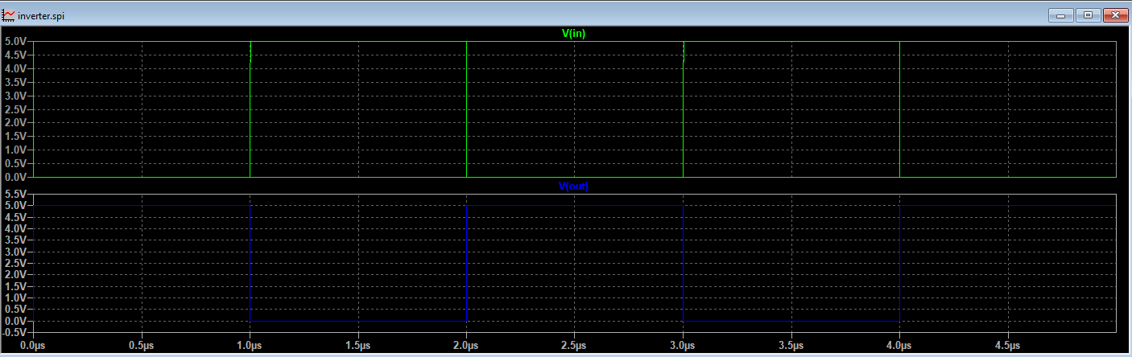
Results and simulations A. Invertor
The simulation of the inverter observed with the expected behavior

Slide 16
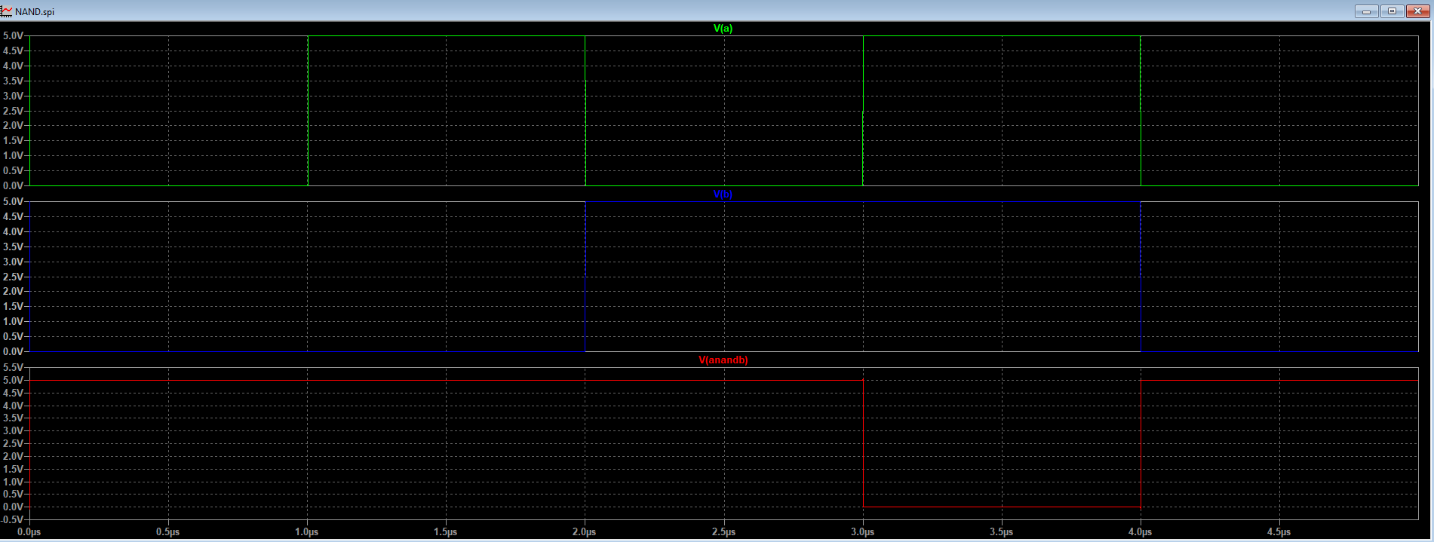
B. 2-input NAND
The simulation of the NAND gate observed with the expected behavior

Slide 17
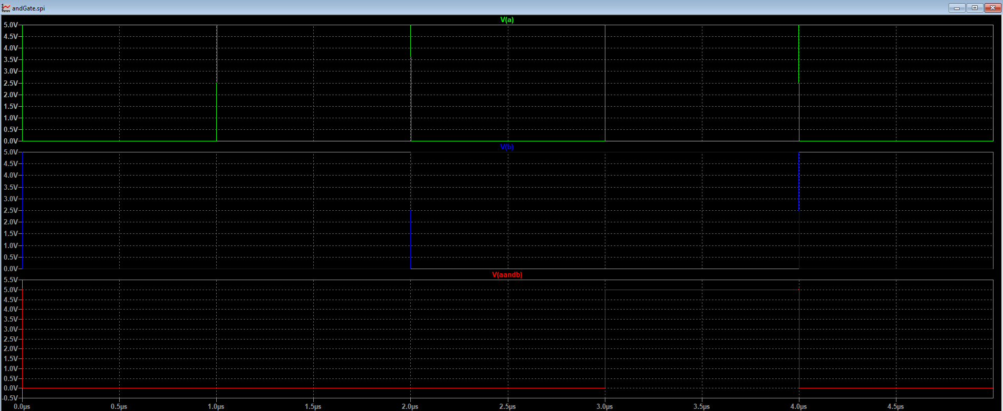
C. 2-input AND
The simulation of the AND gate observed with the expected behavior

Slide 18
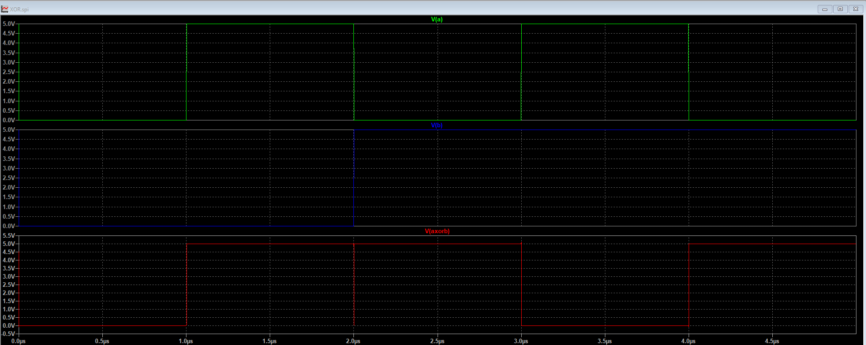
D. 2-input XOR
The simulation of the XOR gate observed with the expected behavior

Slide 19
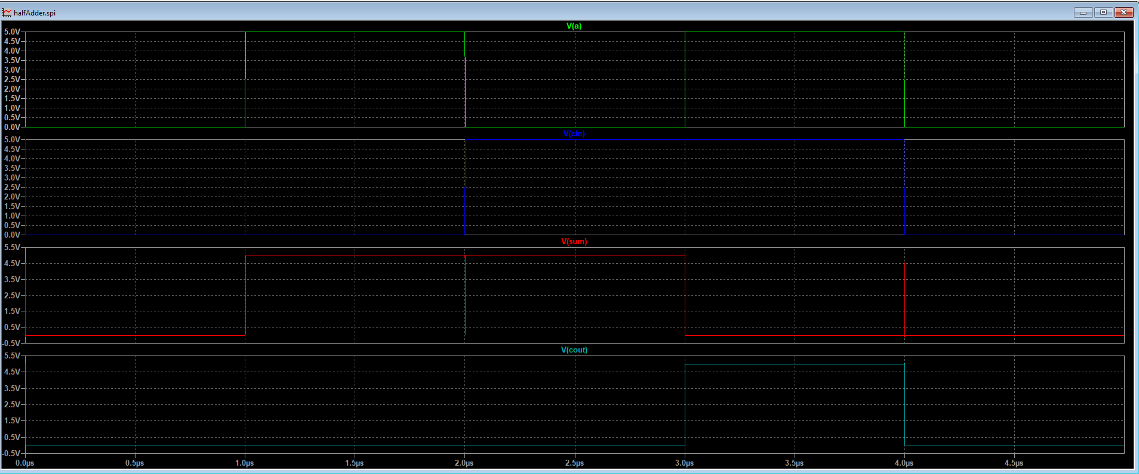
E. half adder
The simulation of the half adder circuit observed with the expected behavior

Slide 20
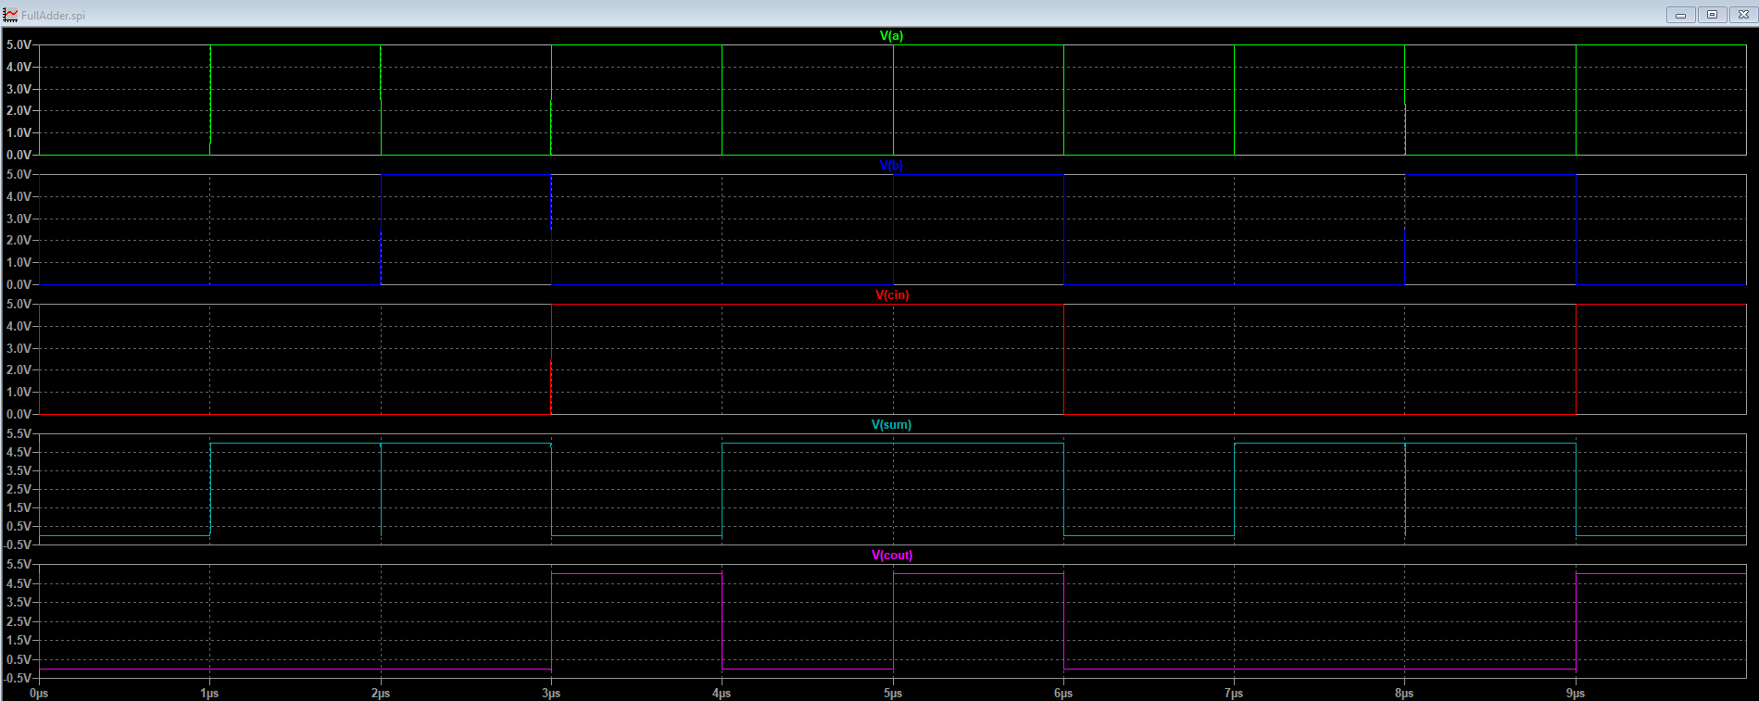
f. full adder
The simulation of the full adder circuit observed with the expected behavior

Slide 21
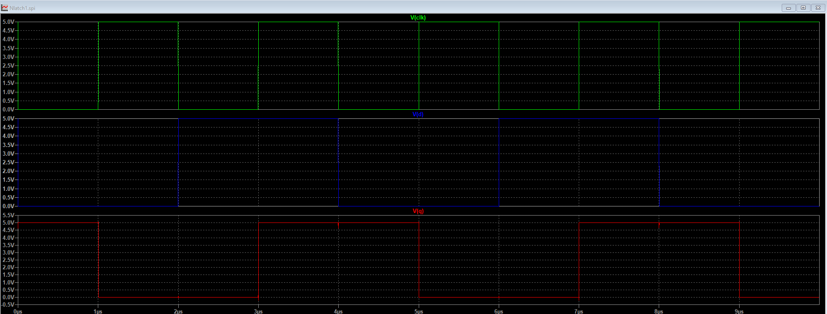
g. N-latch
The simulation of the N-latch circuit observed with the expected behavior

Slide 22
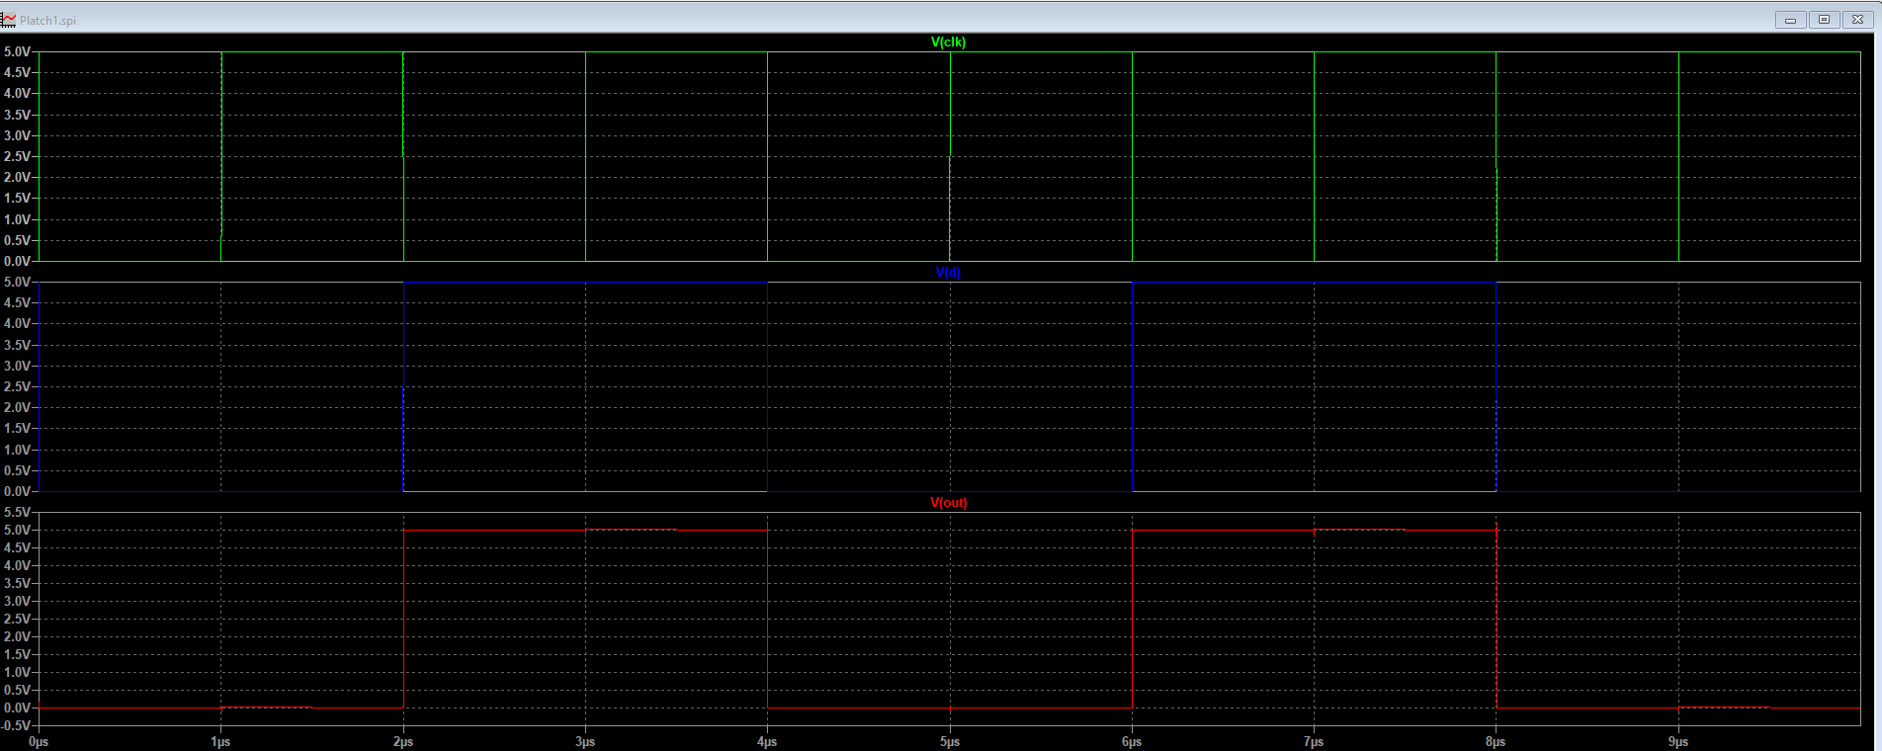
h. p-latch
The simulation of the p-latch circuit observed with the expected behavior

Slide 23
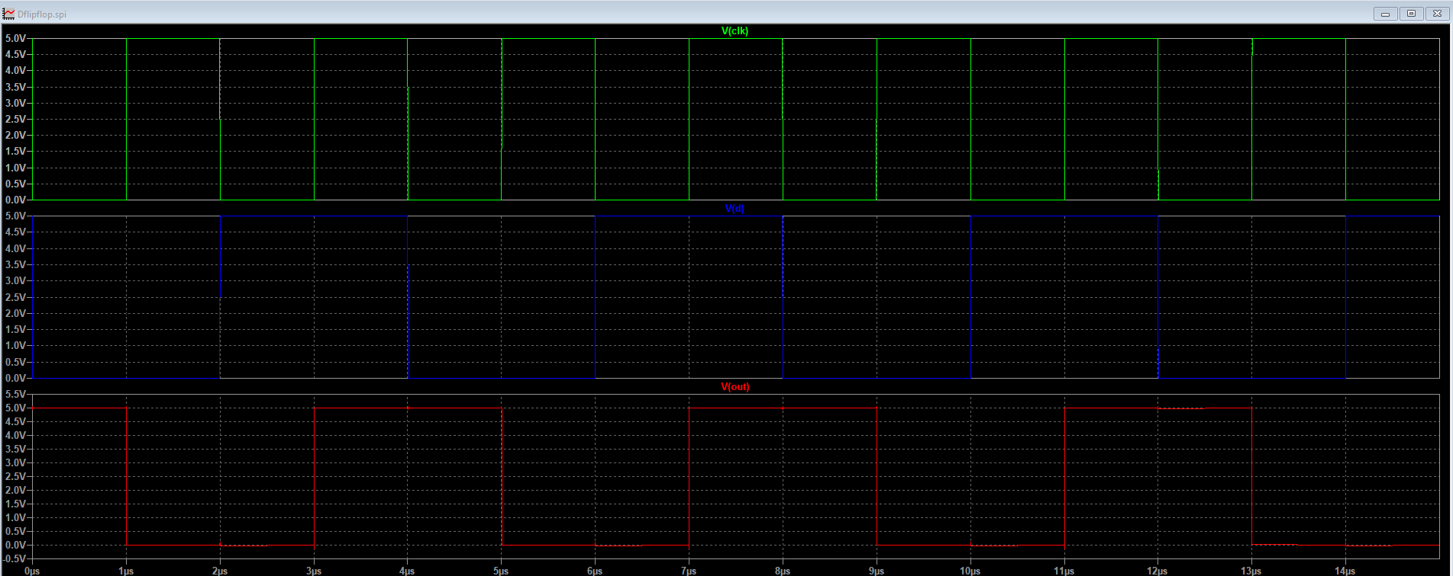
i. d-flip flop
The simulation of the D-flip flop circuit observed with the expected behavior

Slide 24
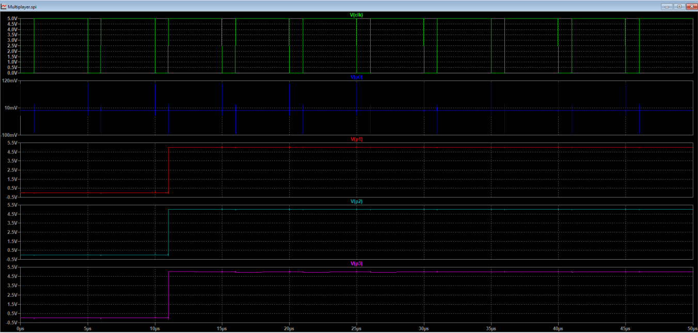
j. 4x4 Enhanced Pipeline multiplier
The simulation of the 4x4 Enhanced Pipeline multiplier circuit observed with the expected result. 1st test case: 2*7= 14 → (0010)*(0111) = (1110)

Slide 25
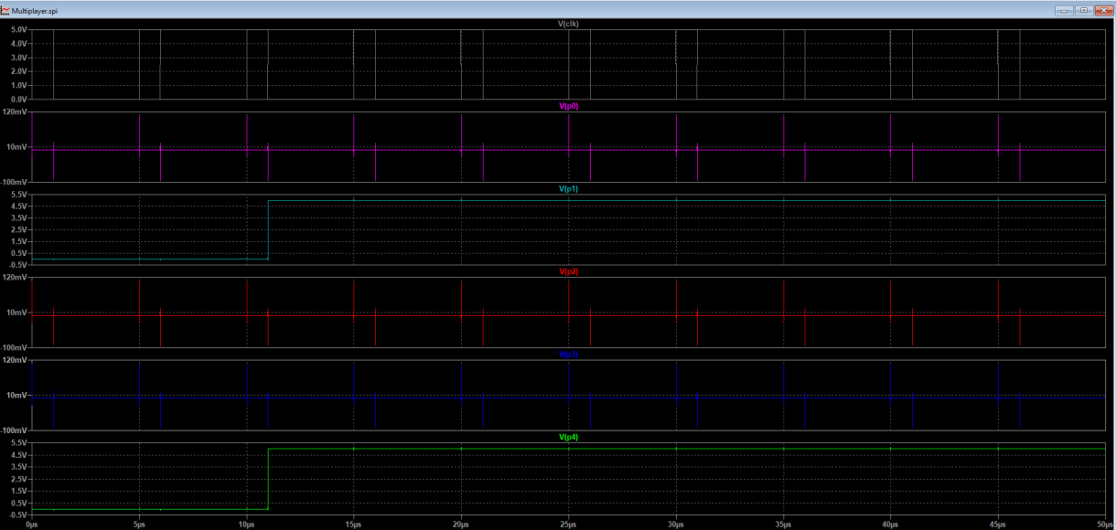
j. 4x4 Enhanced Pipeline multiplier
The simulation of the 4x4 Enhanced Pipeline multiplier circuit observed with the expected result. 2nd test case: 3*6= 18 → (0011)*(0110) = (10010)

Slide 26
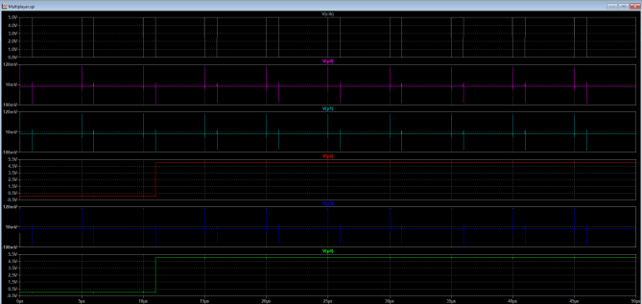
j. 4x4 Enhanced Pipeline multiplier
The simulation of the 4x4 Enhanced Pipeline multiplier circuit observed with the expected result. 3rd test case: 4*5= 20 → (0100)*(0101) = (10100)

Slide 27
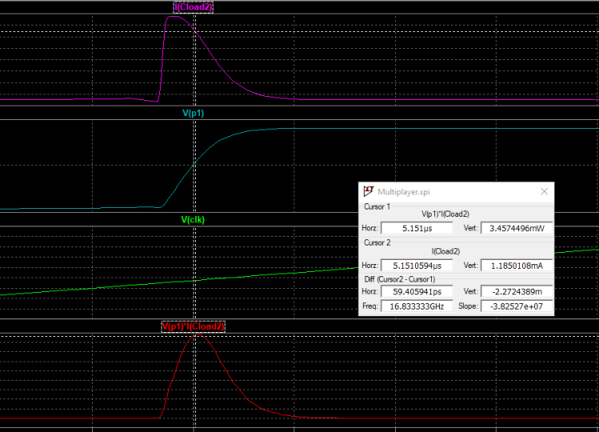
POWER AND DELAY OPTIMIZATION max power
the max power was measured by using a cursor in the curve of V*I, the result 3.4574496 mW was observed

Slide 28
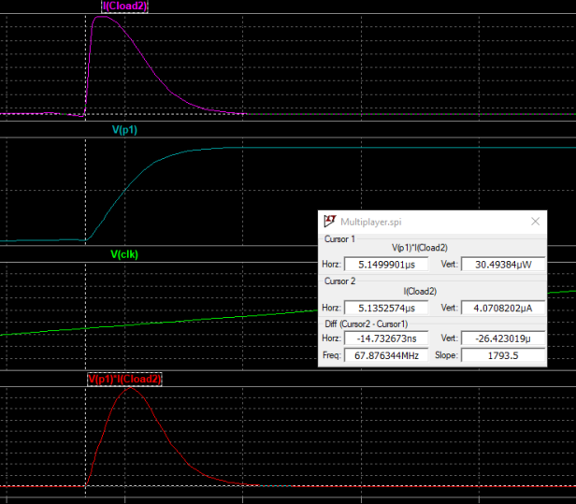
min power
the min power was measured by using a cursor in the curve of V*I, the result 30.49384 uW was observed

Slide 29
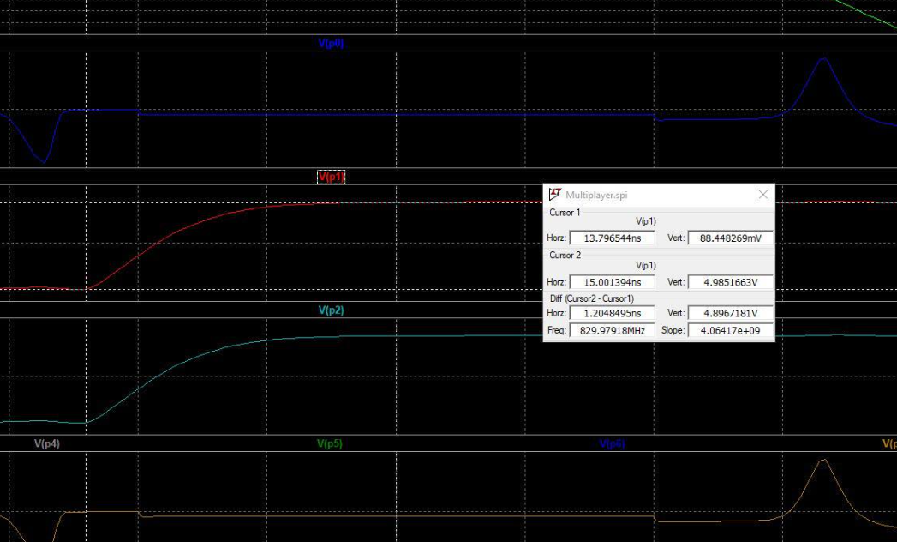
Rise time delay
two cursors were used to measure the difference at the rising time in the curve. the value of rise time delay is 1.2048495ns

Slide 30
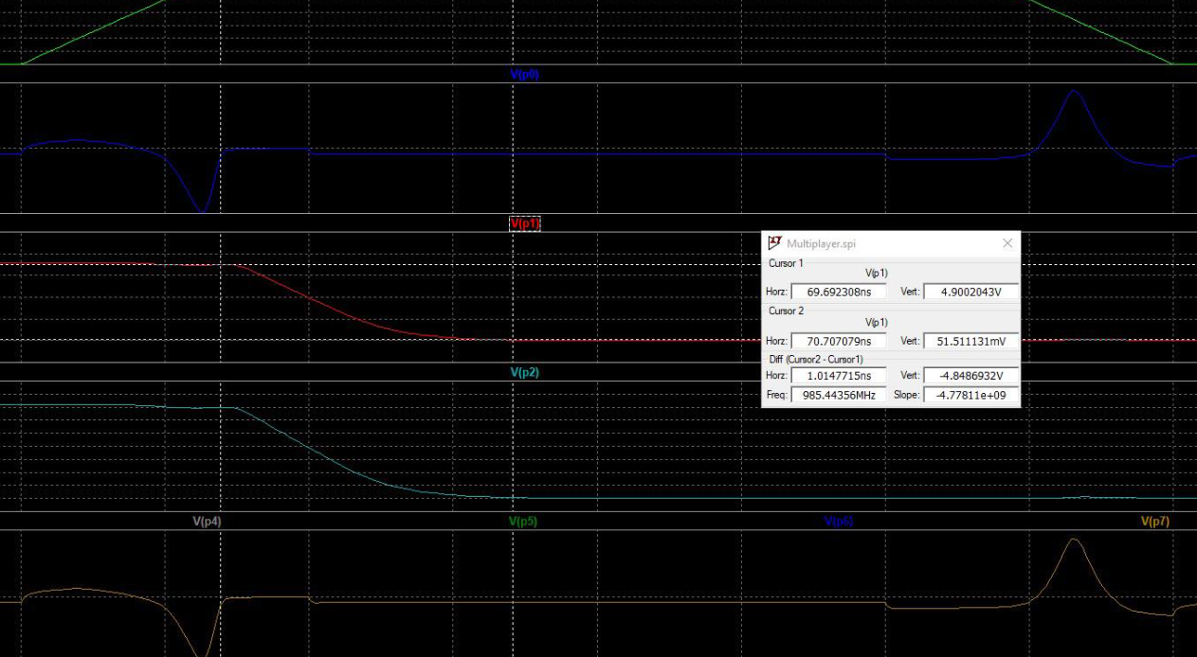
fall time delay
two cursors were used to measure the difference at the falling time in the curve. the value of fall time delay is 1.0147715ns.

Slide 31
Comparison table
compares between three types of multipliers
Conventional 90-T 4x4 multiplier, Proposed 4x4 multiplier, and our system 4x4 Enhanced Pipeline multiplier.
 | Conventional 90-T 4x4 multiplier | Proposed 4x4 multiplier | 4x4 Enhanced Pipeline multiplier (our design)
Avg. Power | 18.15621 mw | 14.32673 mw | 1.7439694mW
Max Power | 0.2267146 w | 0.2471635 w | 3.4574496 mW
Min Power | 0.6970550 mw | 0.49741495 mw | 30.49384 uW
Rise time delay | 1.3875 ns | 1.1020 ns | 1.2048495ns
Fall time delay | 1.2046 ns | 0.9098 ns | 1.0147715ns

Slide 32
CONCLUSION
In conclusion, the schematics and layout designs and implementation steps of 4x4 Enhanced Pipeline multiplier were completed successfully with observed of the expected results thoroughly examined and presented in a comprehensive way. The layout and schematic designs for each component utilized in the final circuit were clearly shown. Notably, simulation results of all circuits were carefully obtained, meticulously analyzed, and effectively communicated, the delay and power for the multiplier were measured and compered with another systems.
This project not only stands as a significant contribution to the field of Integrated circuits, but also opens avenues for future research and developments in this realm.

Slide 33
The end Thank you Yazeed hamdan 1201133 osaid hamza 1200875 Mahmoud hamdan 1201134

